Slide 1

English Reverse Auction

Slide 2
Overview
Ariba Auction is a sourcing event where invited participants submit competitive bids to buy or sell goods and services in real time. Typically run for a short period, Ariba Auctions enable the Project Owner to quickly gather and evaluate responses from all participants, making the process both fast and efficient.
Distinct Features of SAP Ariba Auctions
Multiple auction formats
Customizable auction setup
Real-time interaction with all participating parties
Online price negotiations
Controlled event timing

Slide 3
Overview
There are two types of auctions events within SAP Ariba each designed for different requirements:
Type 1: Reverse Auctions (English)
Reverse Auctions are used to buy goods and services at the lowest price
This is the standard auction type in SAP Ariba
The Project Owner invites suppliers to bid on a specific item or service
As suppliers compete, the price decreases, driving savings through competitive bidding
Type 2: Forward Auctions (English)
Forward Auctions are used to sell goods and services to the highest bidder
The Project Owner invites buyers to participate and compete for the item
As buyers place bids, the price increases, maximizing potential revenue

Slide 4
Auction Format/Template in SAP Ariba
There are three auction formats/templates available in SAP Ariba
English Reverse Auction
Auction where participants submit decreasing bids, aiming to outbid the competitors where the lowest bid wins the offer
Overtime triggers can be configured to extend the event if any last-minute bids are submitted
Option to display supplier information
Dutch Reverse Auction
The Project Owner sets a high starting price, which decreases automatically at defined interval. The first supplier to accept the current price wins the offer
No overtime or pre-bids allowed
Transparent format with supplier information visible
Japanese Reverse Auction
The Project Owner sets a high starting price, which decreases automatically at defined interval. All participants must accept or reject each new price level as it drops. Suppliers who do not accept the lower price are eliminated from the auction. This continues until only one supplier remains, or a target price is reached.

Slide 5
Auction Preparation
For an Auction to be successful, Project Owner must consider the following;
Internal
Always conduct a solicitation beforehand to assess market conditions. Supplier responses to the solicitation can be used as initial bids in the auction.
Adjust market feedback settings to maximize the effect of competition across all bid elements.
Examine all possible cost terms that could impact price.
Run an internal dummy auction to confirm auction settings, rules, and configuration before the live event.
External
Communicate clearly and regularly with the suppliers. Ensure they understand the event timing, and provide detailed registration instructions, especially for those new to SAP Ariba. Remember that some suppliers, especially incumbents may be resistant to participating in auctions.
Notify suppliers in advance so they have time to prepare. Notify them in advance about the required starting price for each lot before the auction.
Conduct an external practice auction to familiarize suppliers with the process, interface, and auction rules, minimizing confusion or technical issues during the live event.

Slide 6
Auction Settings
Bidding Rules
Lot Bidding Formats – Consider your supplier base and award strategy when choosing lot timing.
Parallel: All items open and close at the same time. This format is useful for quickly generating bids across multiple lots. However, it could be challenging to track bids when dealing with multiple items in the auction.
Staggered: All items open at the same time but close in a cascading order. This approach allows suppliers to participate in all items while preventing them from adjusting their strategy midway through the auction.
Serial (recommended): Items open and close one at a time. This format is generally not recommended as it significantly increases the auction duration.
Use the Overtime option to ensure that suppliers have a chance to respond to last minute bids. Set it to trigger in the last 2-3 minutes when a counterbid is placed. This allows lower rank bidders to respond to competitive bids.

Slide 7
Auction Settings
Bidding Rules
Traffic Light Bidding
Displays generic, color-coded information indicating suppliers their rank for each item.
Displays visual representation of most preferred to least preferred bids at a value configured while setting the auction. Helps buyer visually understand how each supplier bids rank for an item.
Improve Bid Amount By
Refers to how suppliers can adjust or improve their bids in Ariba.
Nominal Amount: Suppliers can improve their bids by fixed value.
Percentage: Suppliers can improve their bids by certain percentage of their current bid.
Set Tie Bids
Recommended to select No Tie Bids to maintain fair competition and protect the leading bid.

Slide 8
Auction Settings
Timing Rules
Preview Period
The time between publishing the event and bidding start time.
This rule is only available when Can participants place bids during preview period is configured Yes.
The preview start time starts when the event is published and ends before the bidding start time.
Preview period enable bidders to view the event and submit prebids.
Bidding Start Time and Auction Duration
Clearly define the bidding start and duration time to the bidders before they are invited to the event.
Allow overtime of 2-3 minutes to ensure lower rank bidders can respond to competitive bids

Slide 9
Auction Settings
Market Feedback
Show Lead Bid
Suppliers see the current lowest or highest bid and aim to beat it. Recommended for auctions with larger supply bases (more than 5 suppliers) or in naturally competitive markets.
Results in fewer overall bids, as noncompetitive suppliers drop out and only competitive suppliers respond to the lead bid.
Show Rank
Displays each supplier's current ranking. Can be used together with lead bid in highly competitive events to increase bidding activity.
Show Rank setting (no lead bid) may be useful if the supply base is small, sensitive, or when there are concerns about price sharing/fixing.
This typically results in more bidding activity, as suppliers adjust their bids in competition for first place.

Slide 10
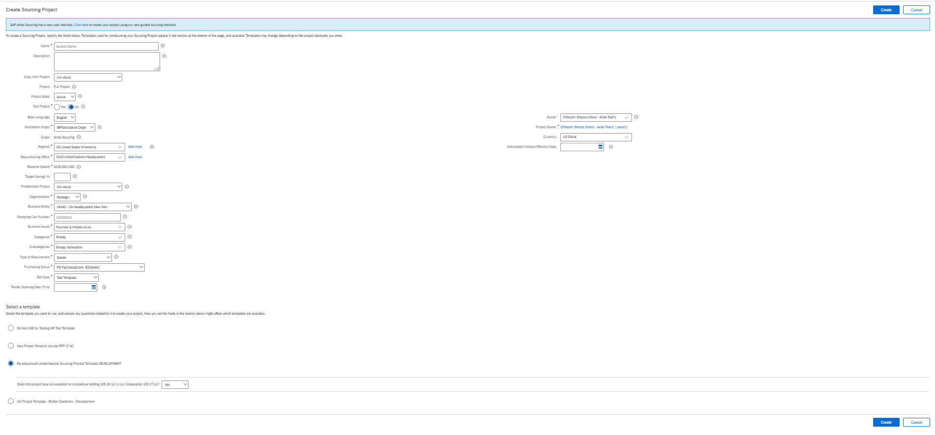
Project Setup
Locate to the solicitation created for which an Auction event is decided to be performed. On the Overview tab -> Actions -> Create Follow-on Project and select Create Sourcing Project.
Select the desired Bid Type and select Re sequenced United Nations Sourcing Process Template Development – Yes
Choose Auction

Slide 11
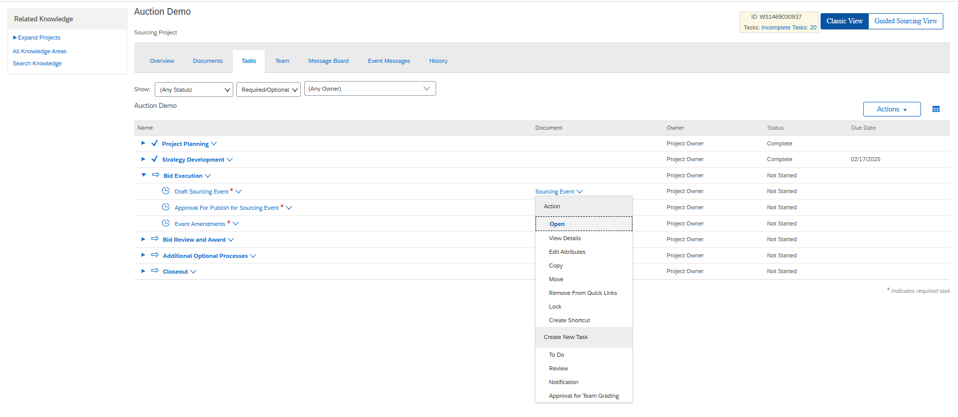
Project Setup
Complete all the tasks up to Strategy Development as done for other solicitation.
Select Sourcing Event and click Open.

Slide 12
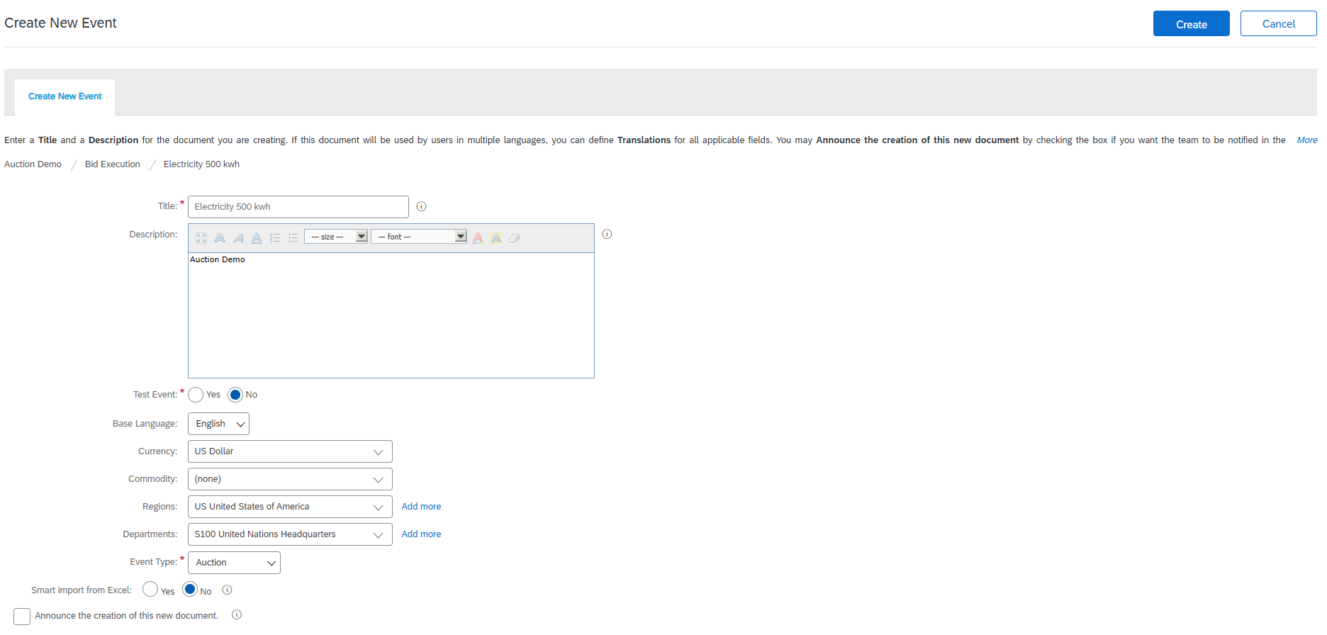
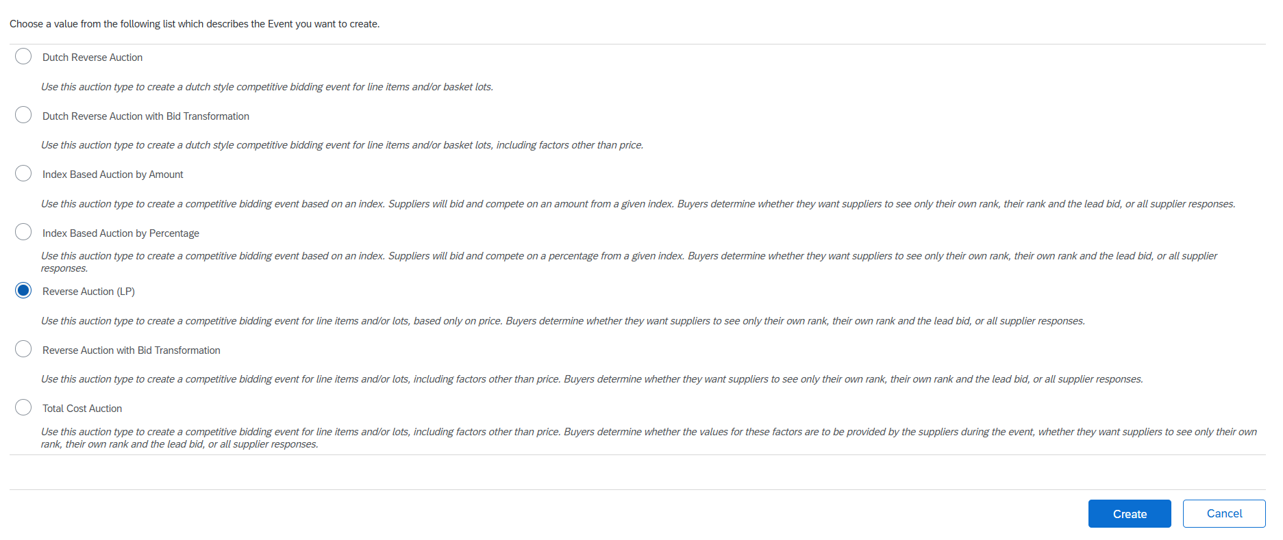
Auction Setup
Enter the Auction name in the Title that would be visible to the suppliers.
Configure the Event Type to Auction and choose English Reverse Auction and Create
Standard Auction Format

Slide 13
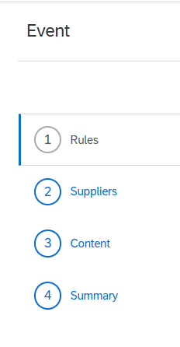
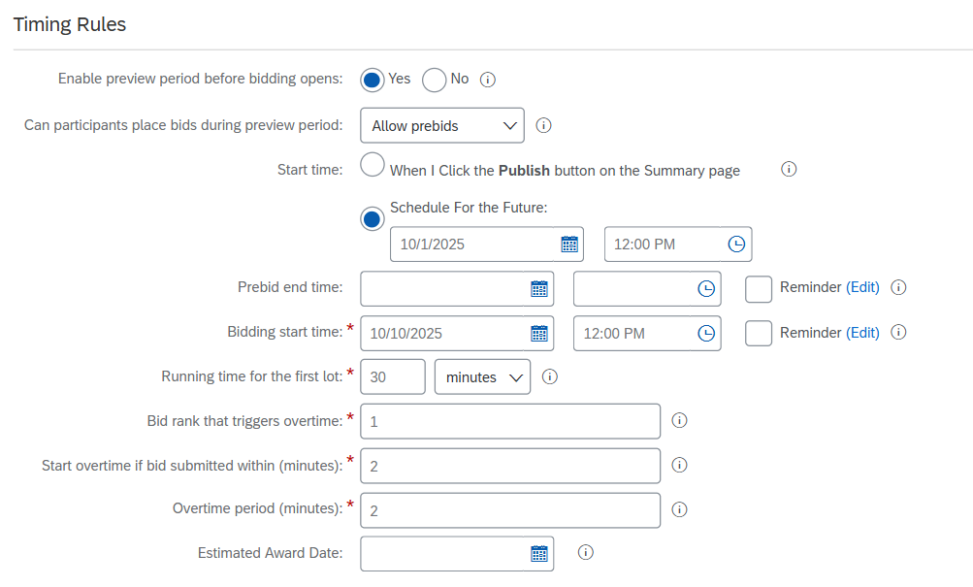
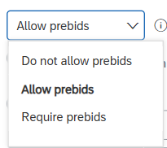
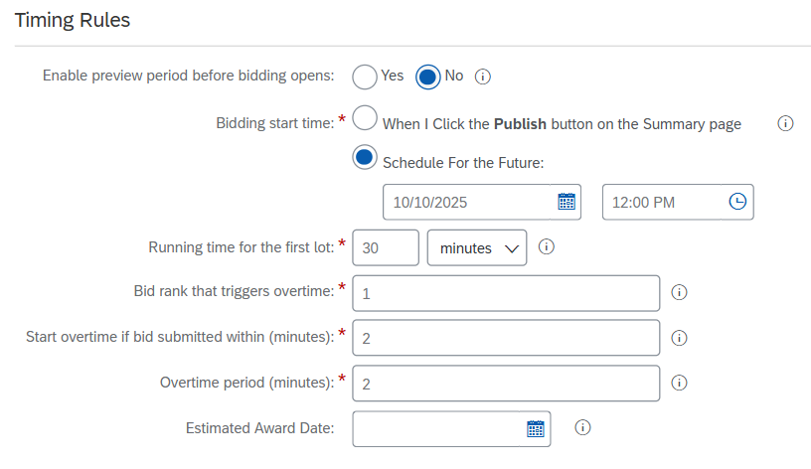
Auction Setup
Set up the Event Rules as based on your conditions
Timing Rules
Enable preview period before bidding opens to allow bidders to submit prebids and access event information.
If pre-bid is allowed & required; select the start time
Enter the running time for which you would like the auction to be open for
If a bid is submitted within 28 to 29 minutes of closing time, an overtime is triggered
Overtime (minutes)
Overtime is only triggered if the counterbid is one rank above the leading bid
Auction duration for first lot

Slide 14
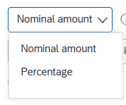
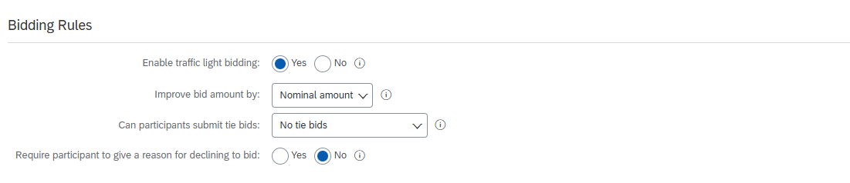
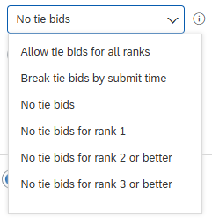
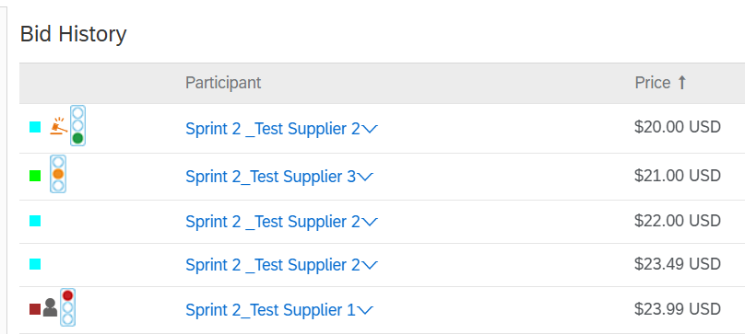
Auction Setup
Bidding Rules
Enable Traffic light bidding to provide suppliers with a quick and easy way to view their position with 3 colors representing a value further configured in the lot section.

Slide 15
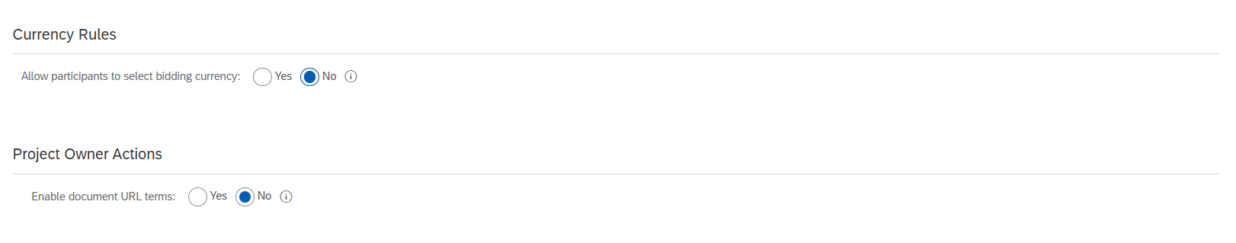
Auction Setup
Set up the Currency Rules and Project Owner Actions.
Recommend (US dollars) to ease the bidding process.

Slide 16
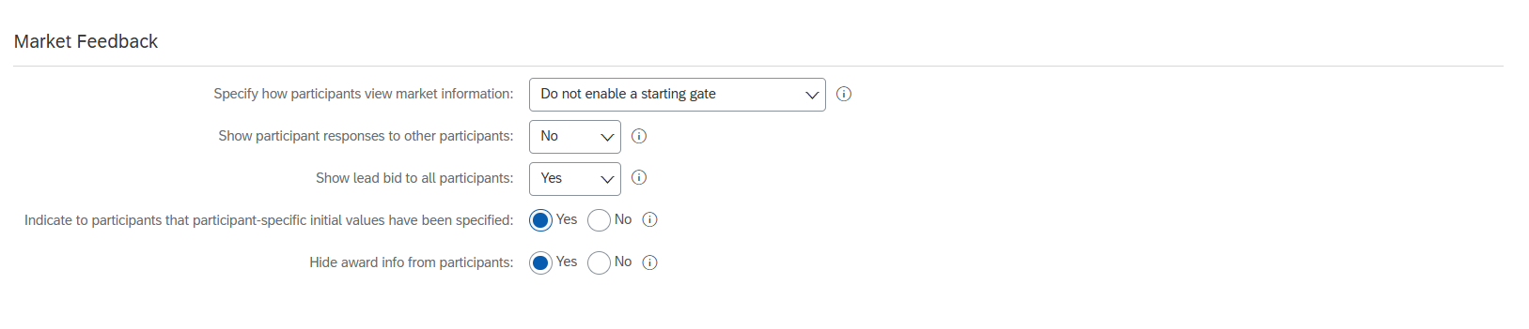
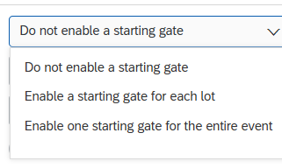
Auction Setup
Market Feedback
Transparency of information about other participants.
Do not enable a starting gate: maximum exposure of information during bidding.
Enable a starting gate: medium exposure of information before submitting a bid.

Slide 17
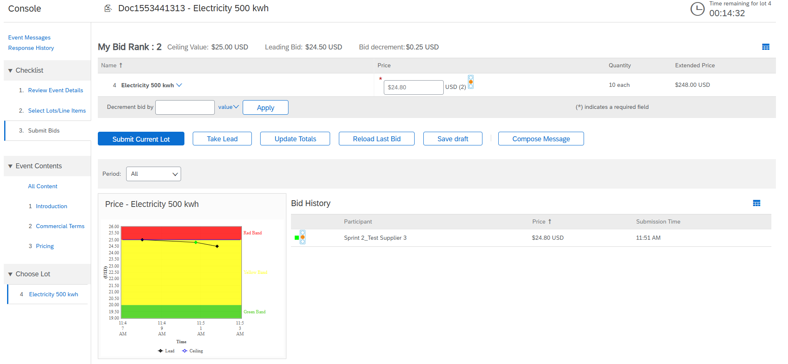
Auction Setup
Market Feedback
If show participants responses to other participants is disabled
Supplier's information and their bid is not visible (Not recommended)
Other participants information is hidden

Slide 18
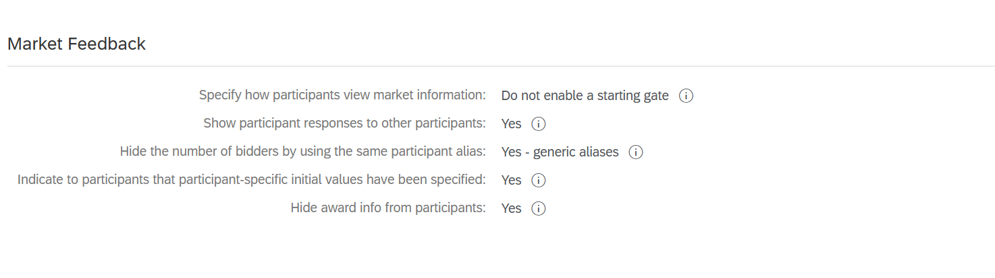
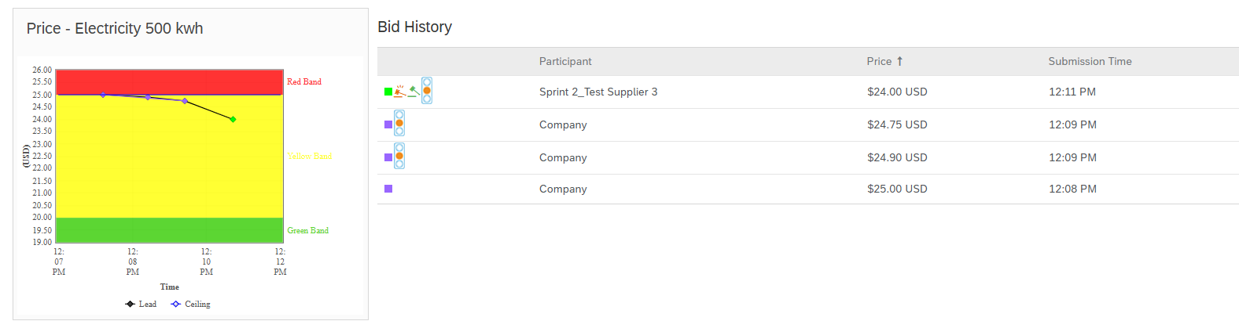
Auction Setup
Market Feedback
If show participants responses to other participants is enabled, then;
Hide the number of bidders --> Yes – generic aliases
Suppliers are completely anonyms and named Company to hide the number of participants invited
Suppliers are given alias names​
Suppliers are anonyms

Slide 19
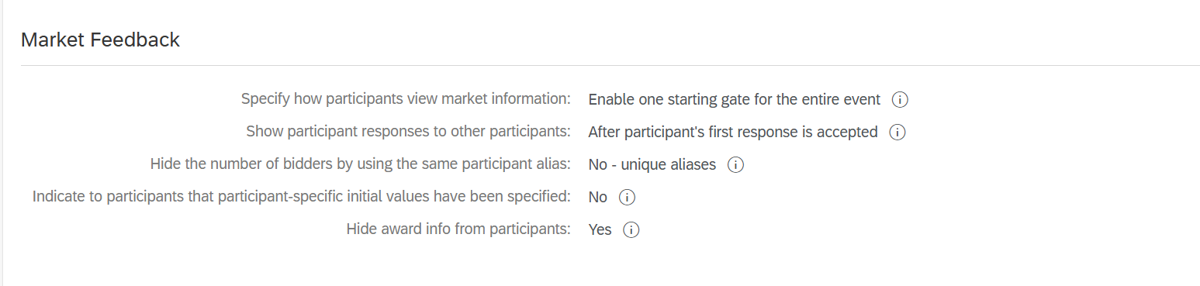
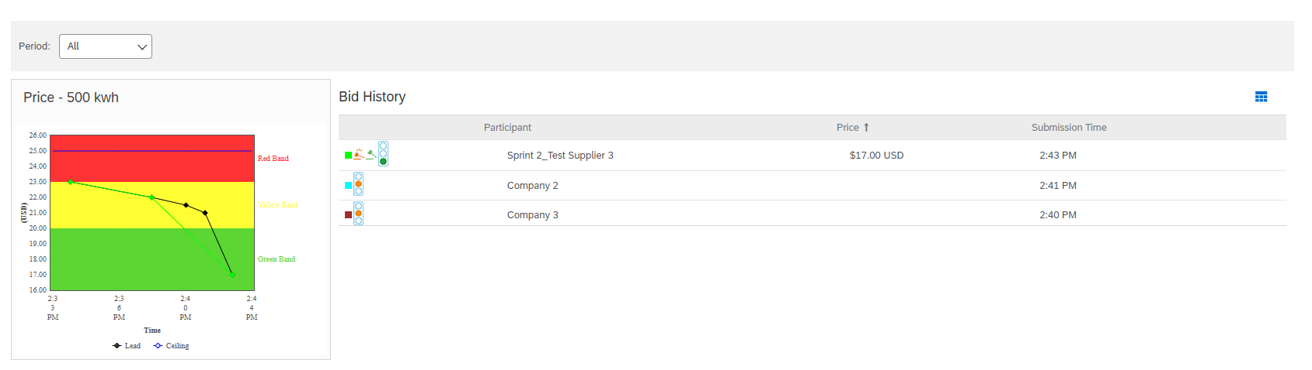
Auction Setup
Market Feedback
If show participants responses to other participants is enabled, then;
Hide the number of bidders --> No – unique aliases
Suppliers are given alias name and know number participants invited
Participants bids are hidden
Suppliers are given alias names​

Slide 20
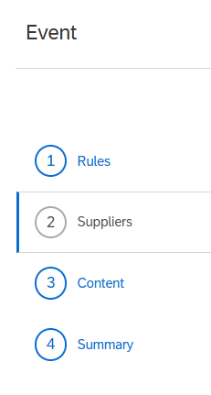
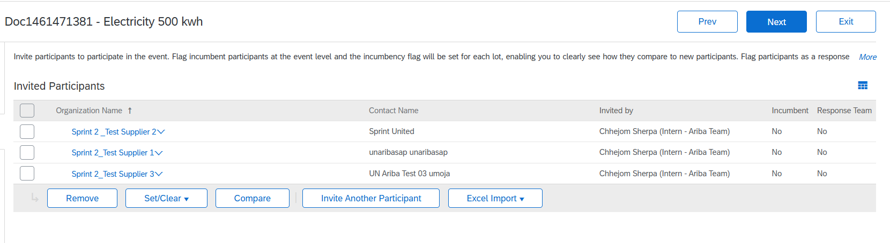
Auction Setup
Invite suppliers shortlisted from solicitation.
No response team.

Slide 21
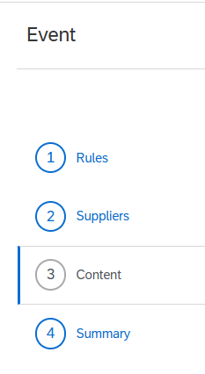
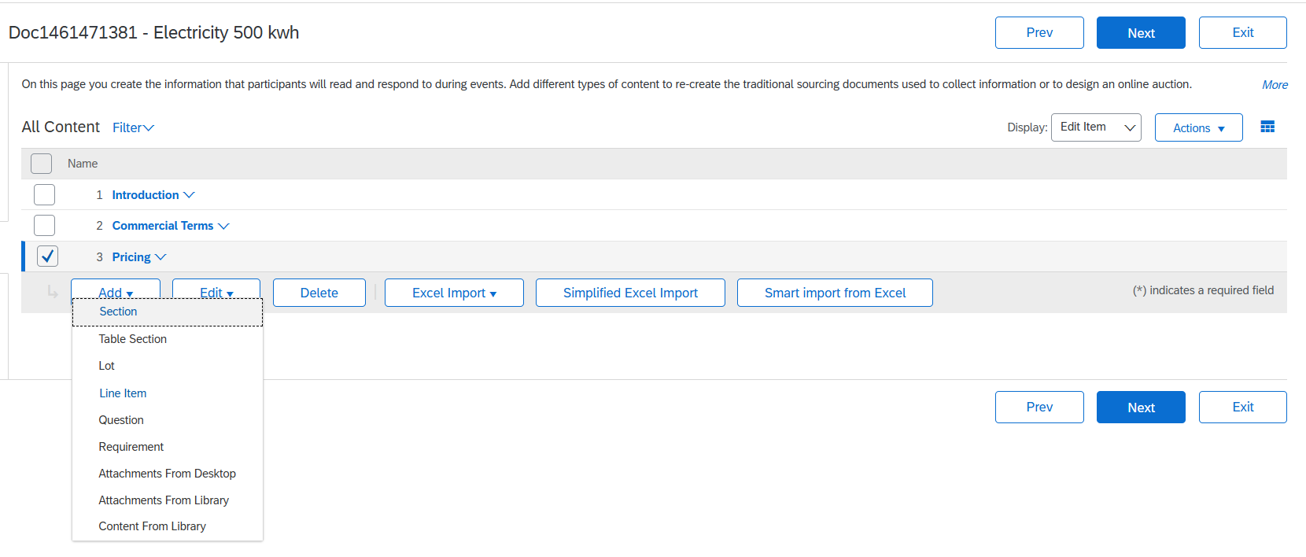
Auction Setup
Enrich content section accordingly based on your event requirements.
Add Lot or Line Item.

Slide 22
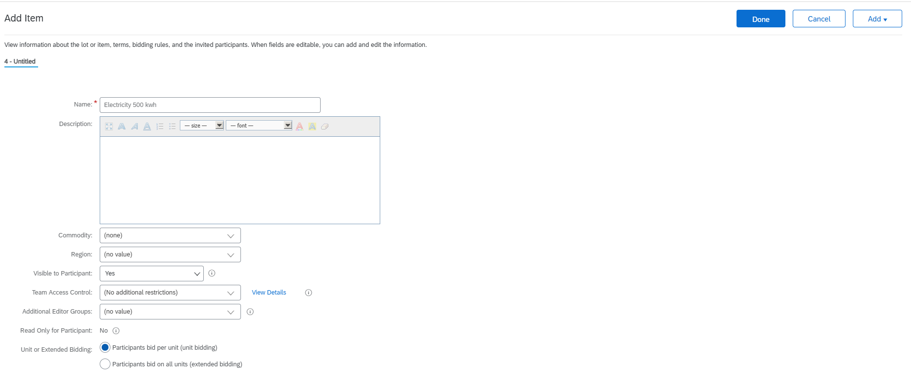
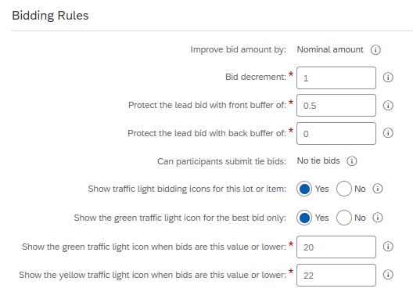
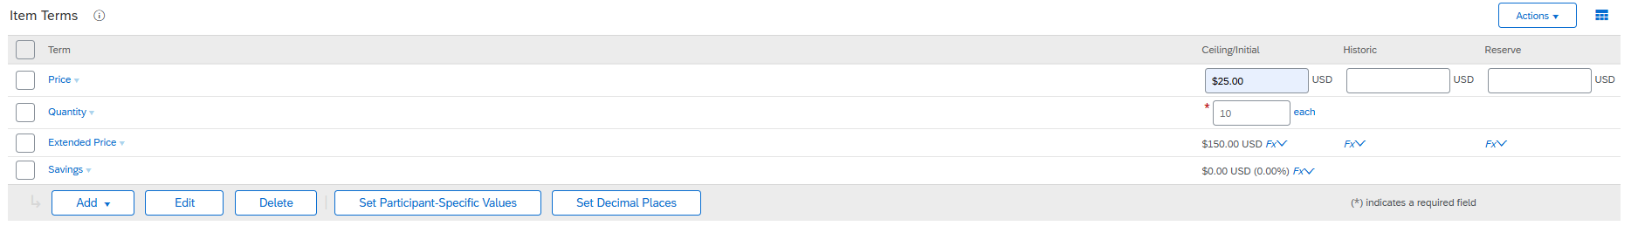
Auction Setup
Edit the Item section and enter the quantity number of commodity purchasing.
Enter the Ceiling price and Quantity.
Bid offer must be lower by 1 from the previous bid submitted
How much subsequent bid must improve from lead bid
If leading bid is 10 than the next bid by the participant should be 9.5. Also applied during pre-bidding phase
Set the value to trigger traffic light

Slide 23
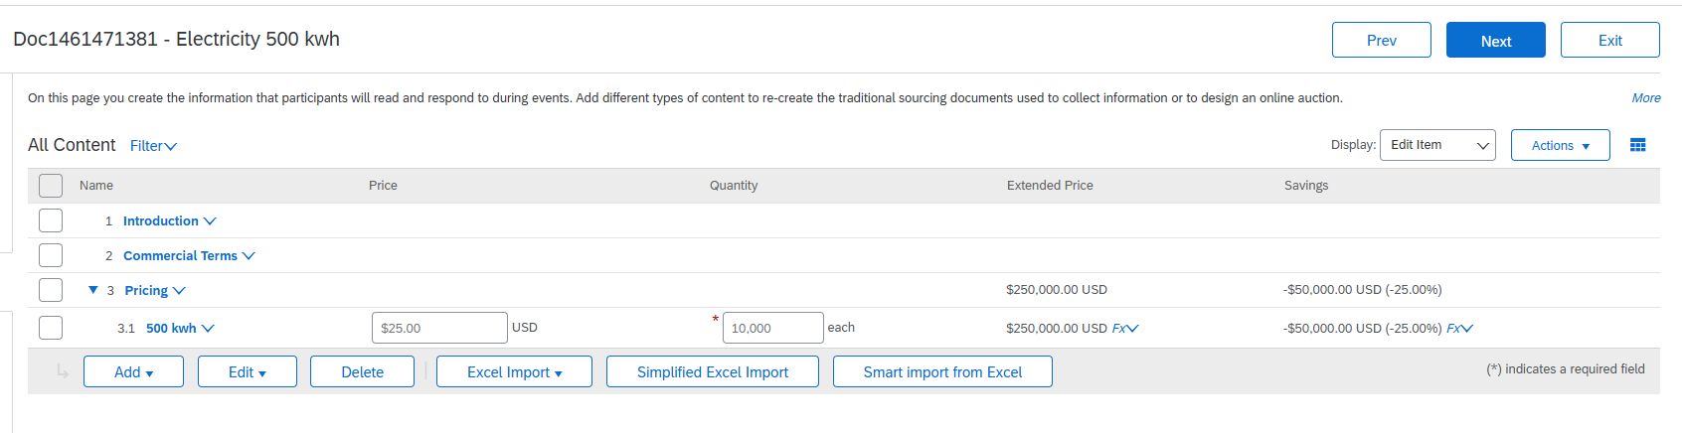
Auction Setup
Line Item added

Slide 24
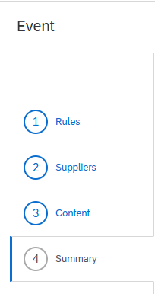
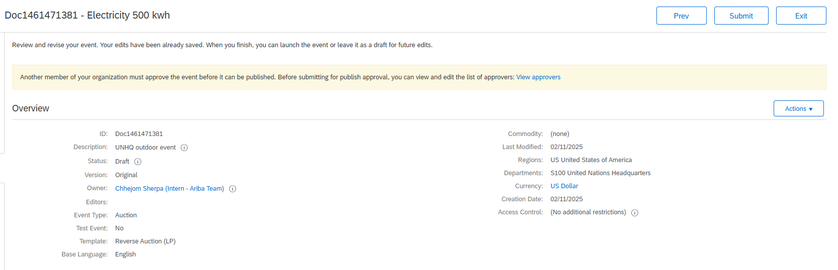
Auction Setup
Once the Event Rules edit is complete, submit it for approval and publication.

Slide 25
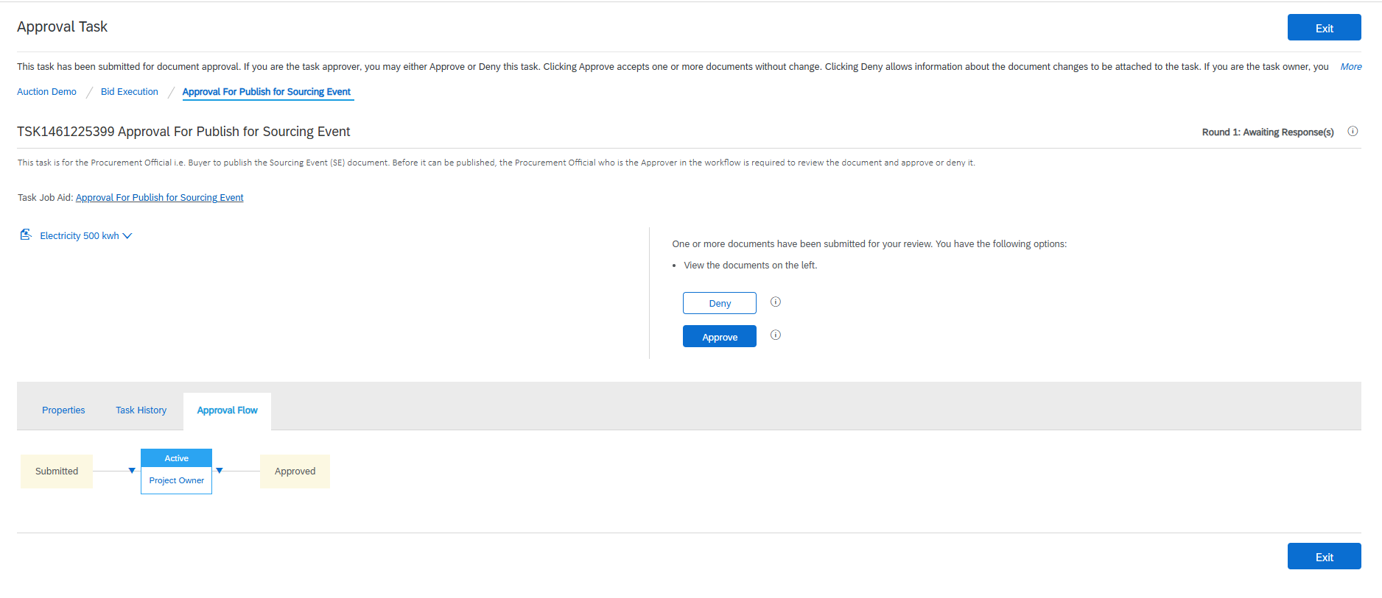
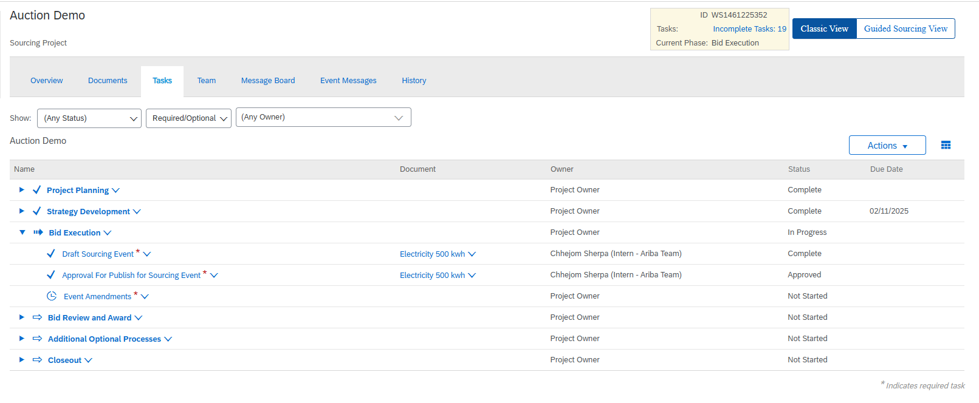
Auction Approval
Task Approval for Publish for Sourcing Event is completed

Slide 26
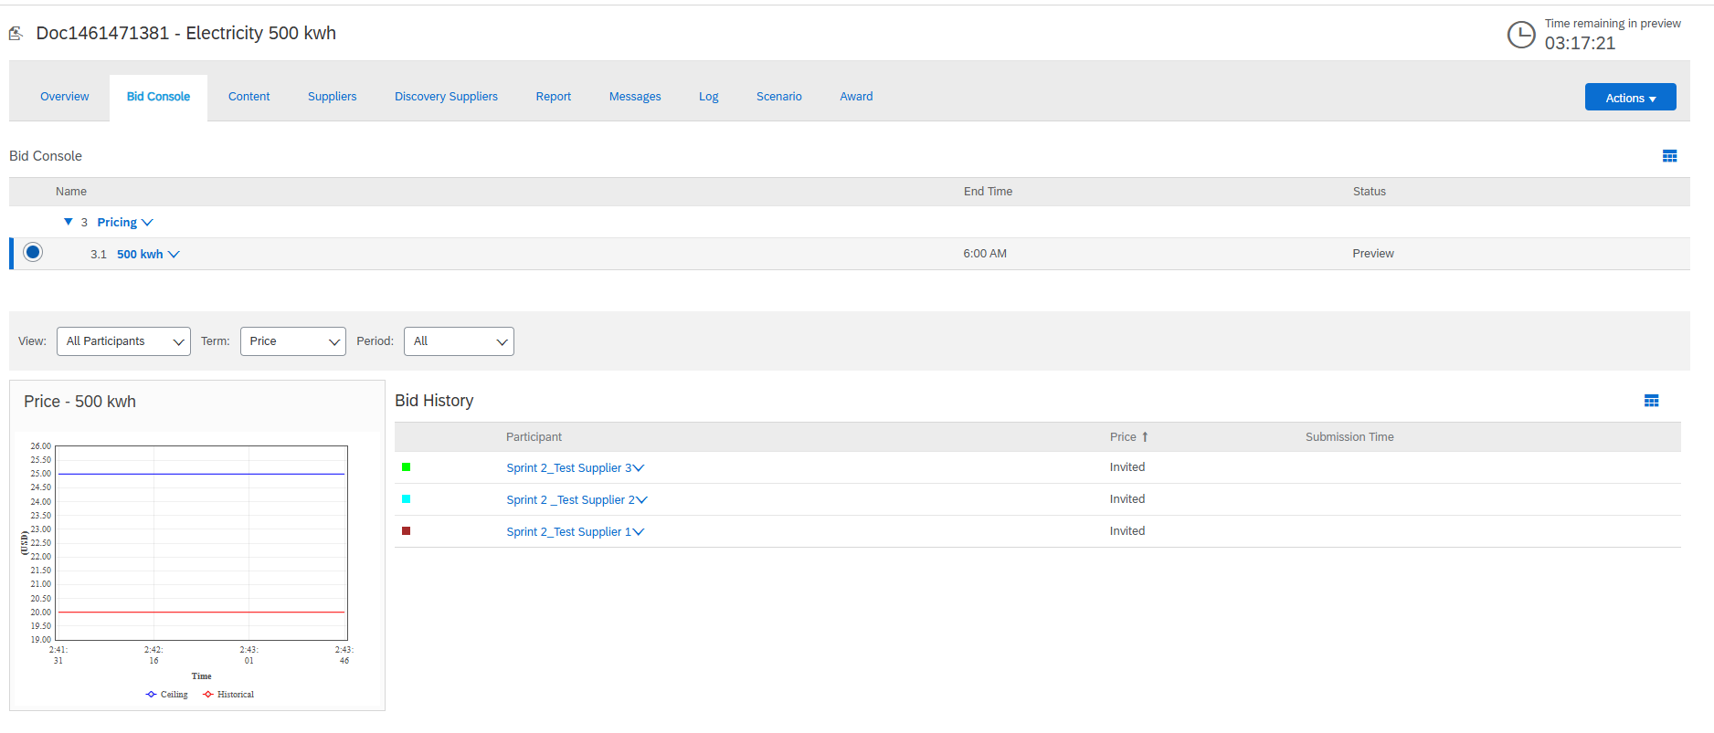
Auction Interface (Preview)
Overview (Bid Console)
Preview period
Name of the Auction
Item name
Auction end time
Auction status
Invited supplier

Slide 27
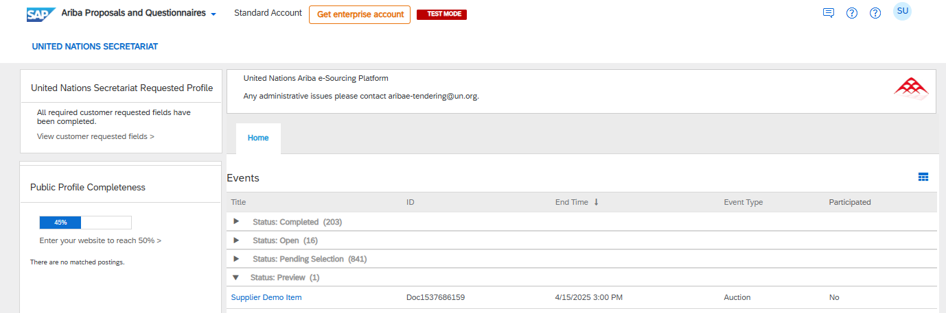
Bidders Interface (Preview)
Note: Ensure that all bidders have accepted the terms of bidding and have submitted the prebid (if allowed) before the auction goes live.
Step 1. Sign-in to your Ariba account with your bidder's credential. On the homepage click on Event section and under Status: Preview locate to the event.

Slide 28
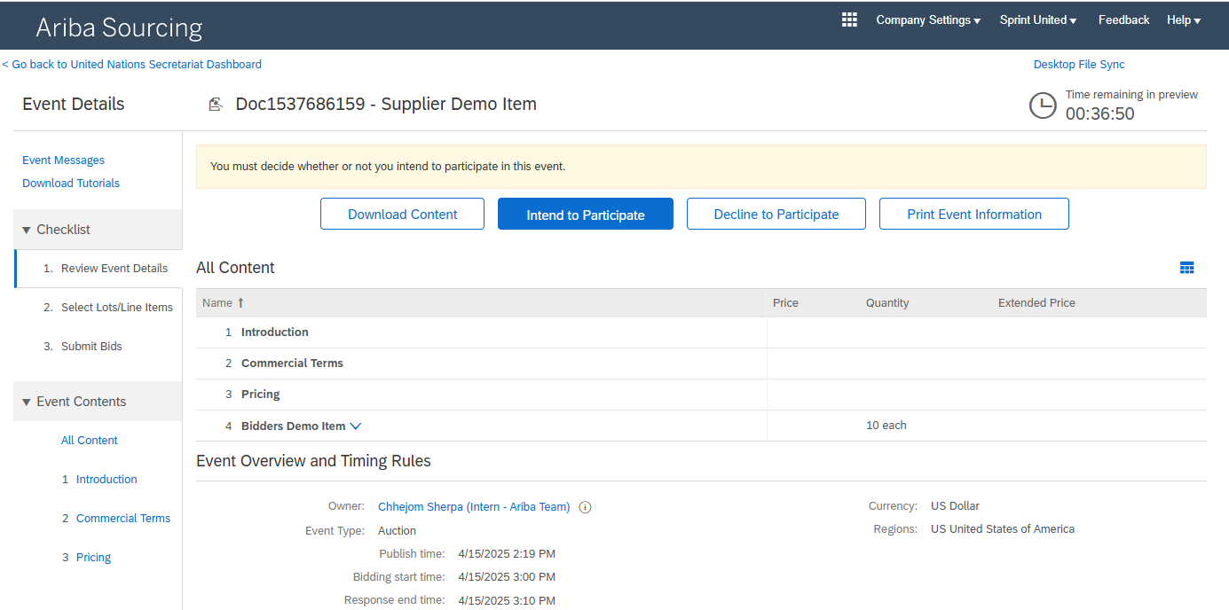
Bidders Interface (Preview)
Step 2. Bidders will be redirected to the Auction event. Click on Intend to Participate to accept the terms of Auction. The Auction event page contains information regarding Event Overview and Timing Rules.

Slide 29
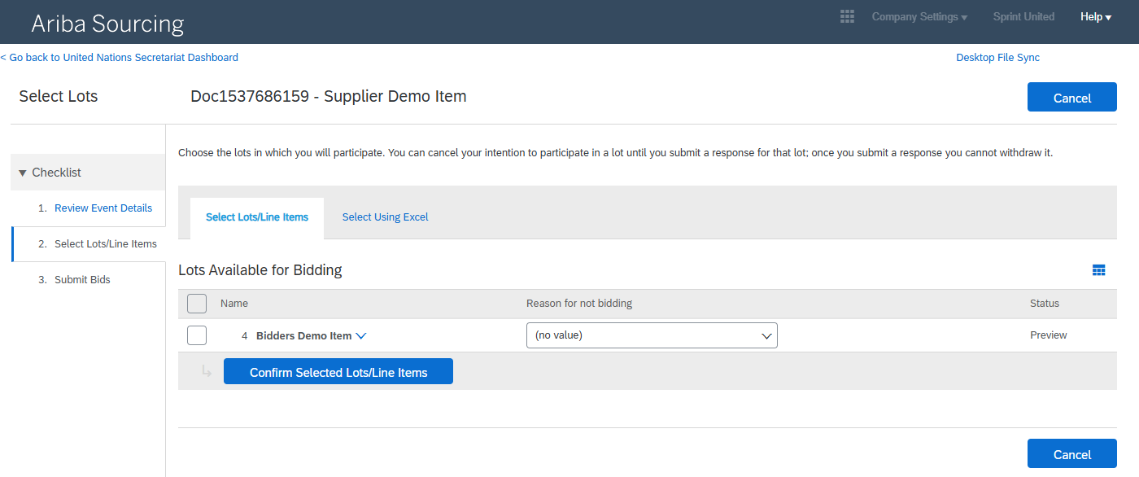
Bidders Interface (Preview)
Step 3. Once the terms of the Auction is accepted, bidders would be directed to confirm the lots available for bidding. Check box the lot the bidders wish to bid and Confirm Selected Lots/Line Items.

Slide 30
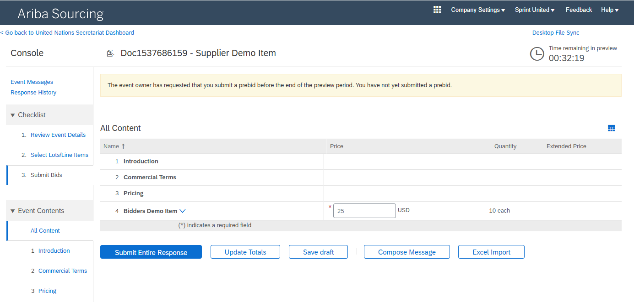
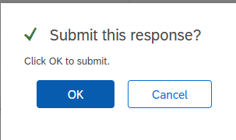
Bidders Interface (Preview)
Step 4. The bidders will be taken to bidding section. Enter the price per quantity amount and Submit Entire Response to submit the initial bid.

Slide 31
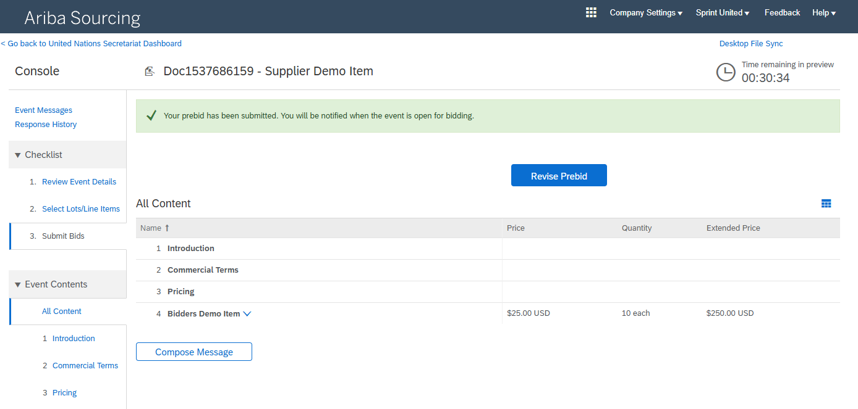
Bidders Interface (Preview)
Step 5. The response has been submitted. If the bidders wish to revise the pre-bid, the Revise Prebid button would redirect to the page to revise the amount.

Slide 32
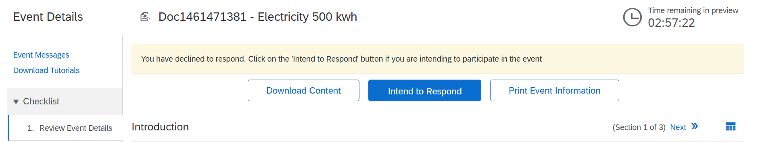
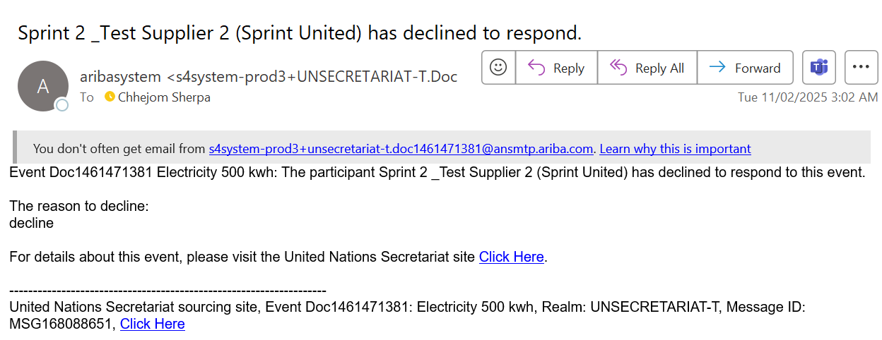
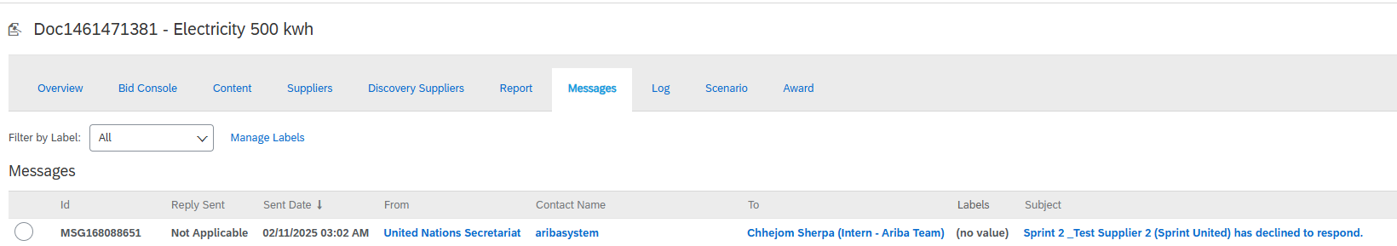
Auction Interface (Preview)
A message alert is sent via an email when the suppliers declines to participate.
No alert sent if a suppliers intends to bid.
Email Alert
Console Message Alert

Slide 33
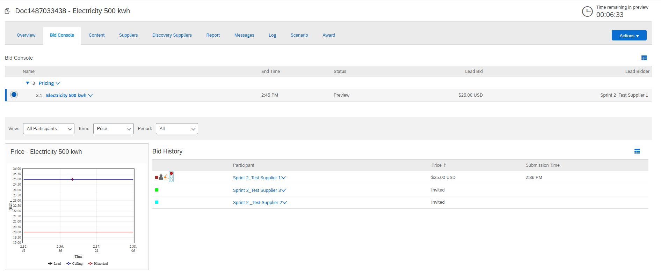
Auction Interface (Preview)
Bid console would indicate bidders who have accepted the terms and submitted their initial bid.
Preview
Lead Bid

Slide 34
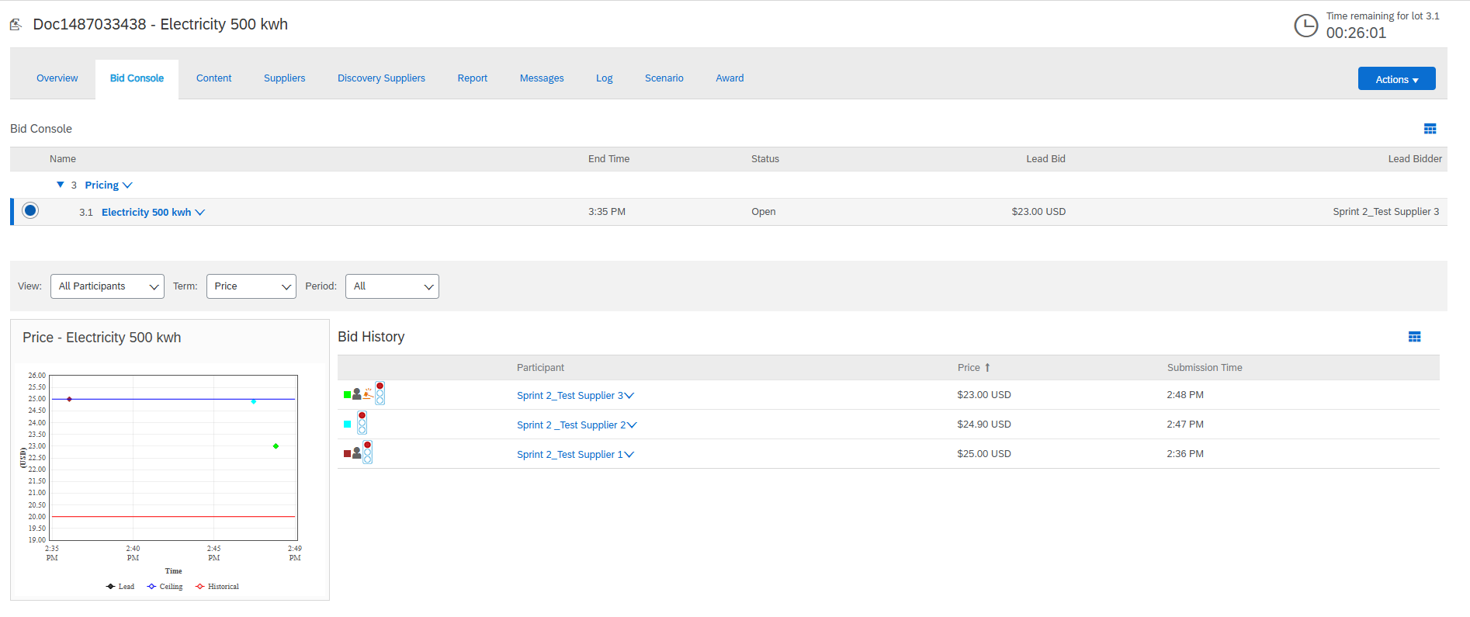
Auction Interface (Live)
Overview (Bid Console)
Open
Lead Bid
Traffic Light Indicator
Generic Aliases Configuration​
All participants onboard

Slide 35
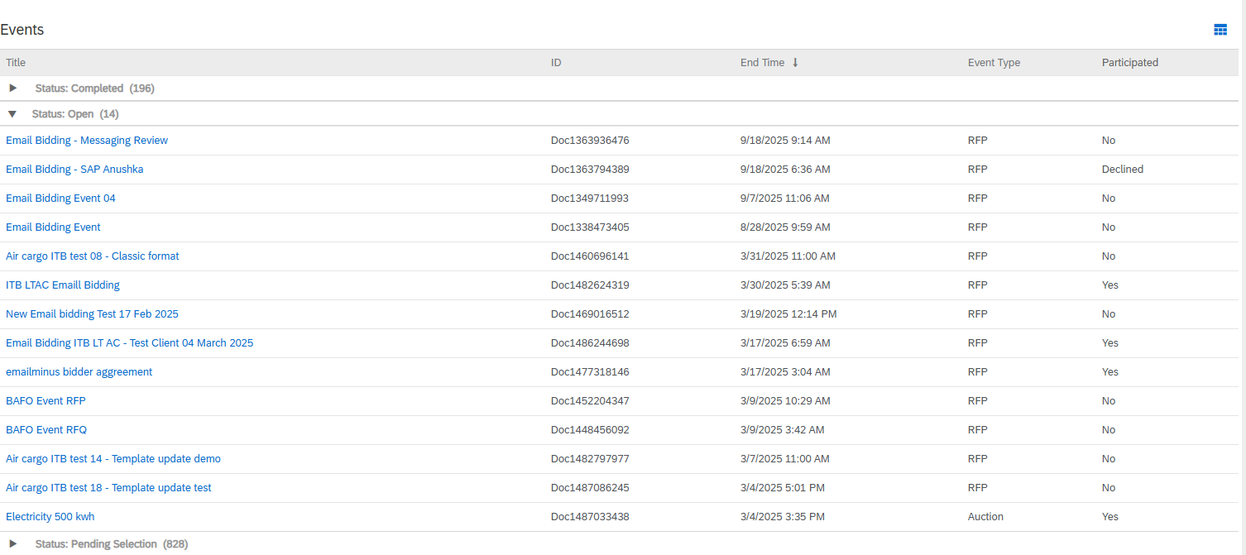
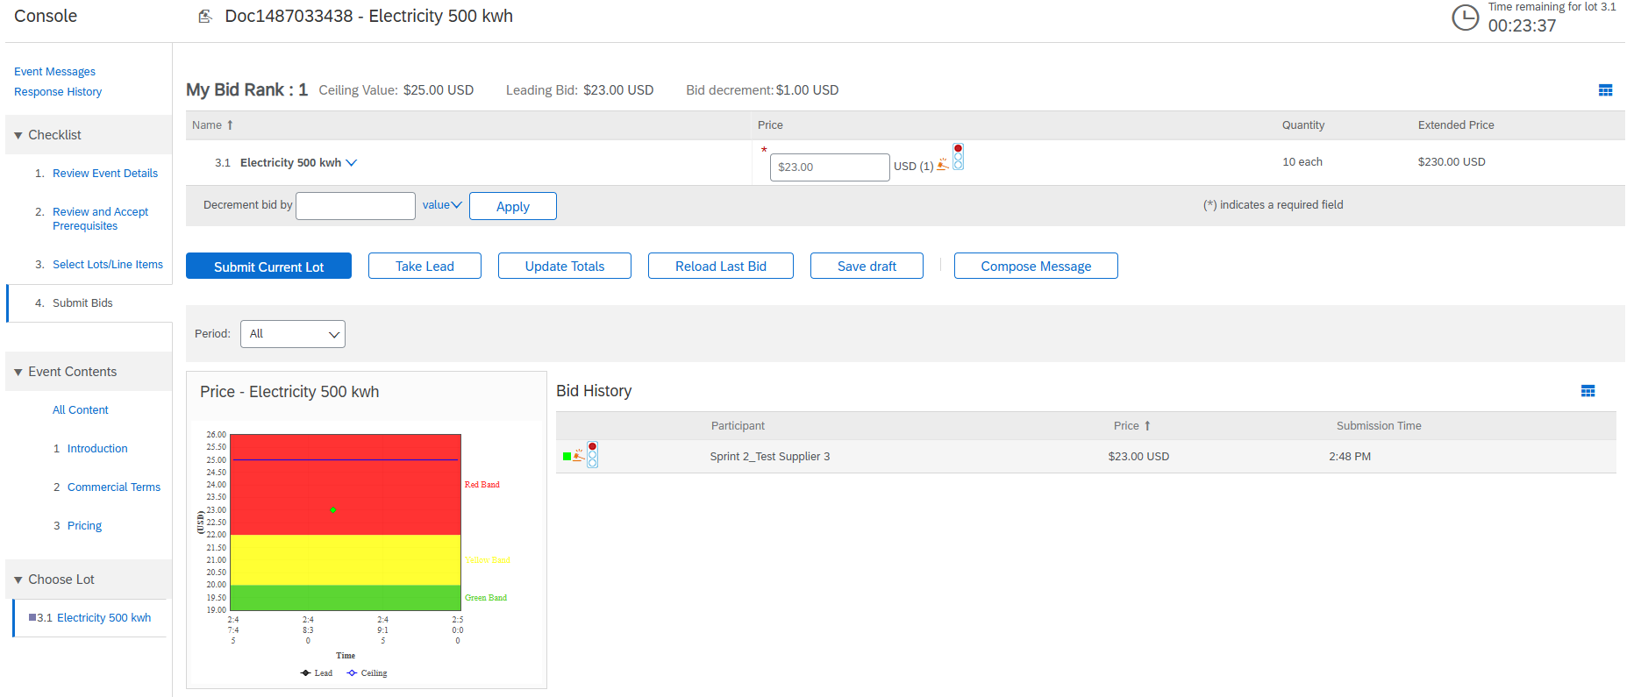
Bidders Interface (Live)
Locate the event under Status: Open
Console is triggered when a bid offer is submitted

Slide 36
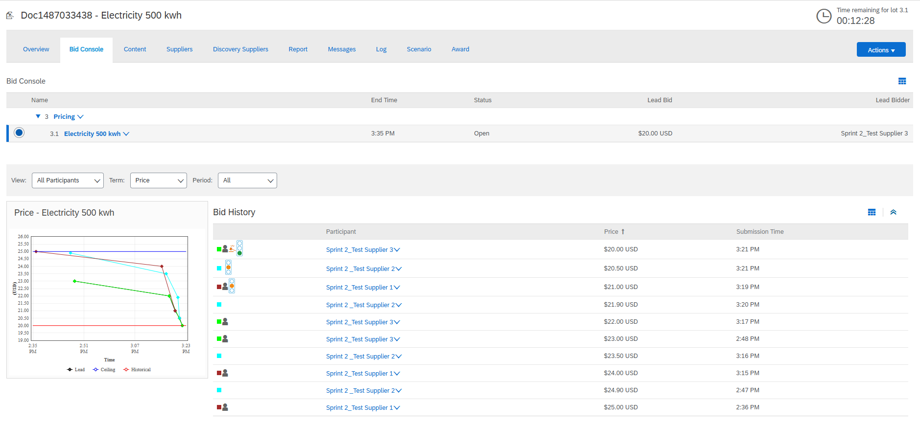
Auction Interface (Live)
Overview (Bid Console) of bidding triggers

Slide 37
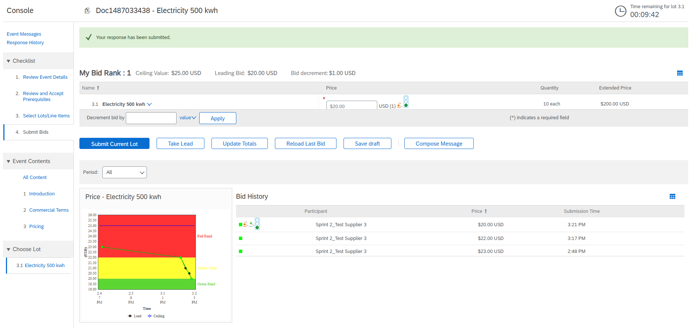
Bidders Interface (Live)
Overview (Bid Console) of bidding triggers

Slide 38
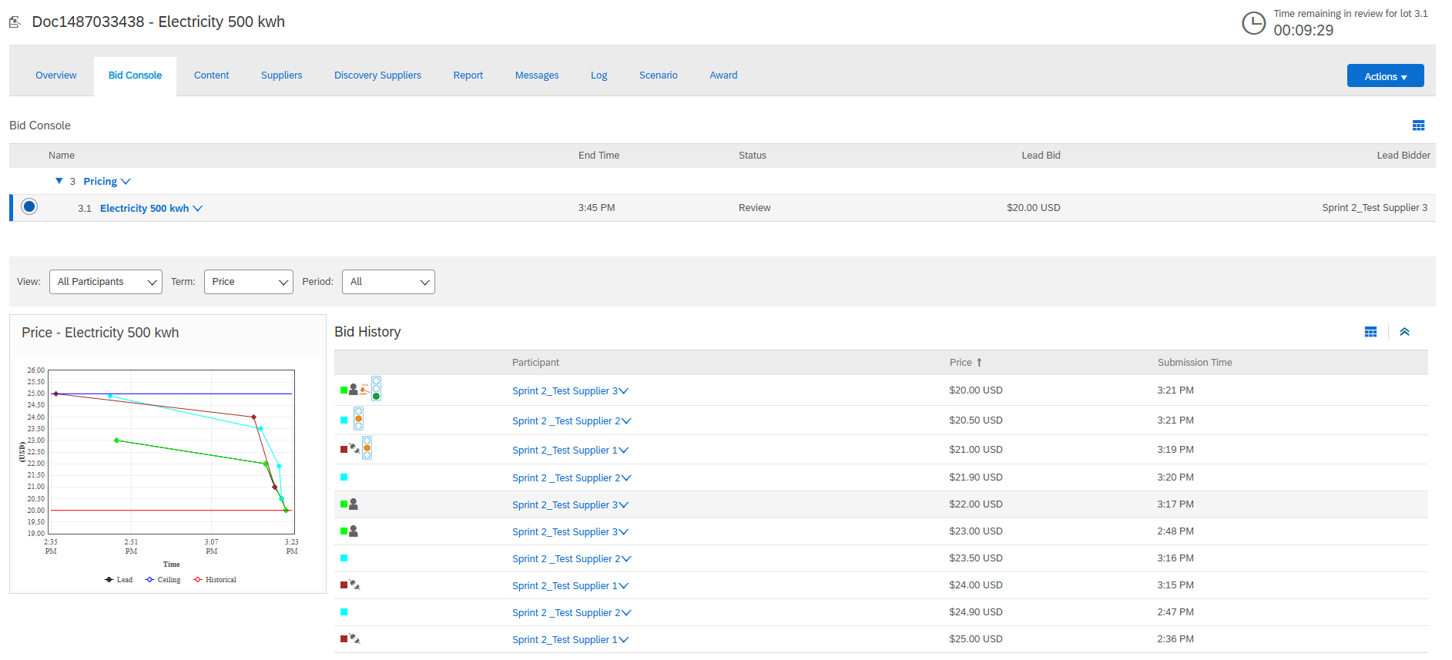
Auction Interface (Review)
Review
Review
Lead Bid

Slide 39
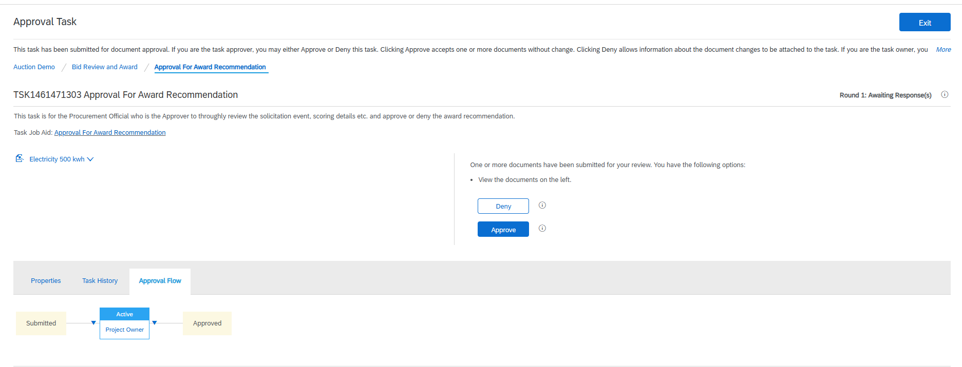

Approval for Award

Slide 40


Bidders Interface (Closeout)
Supplier 3
Supplier 1

Slide 41
Appendix

Slide 42
Figures. Lot Bidding Format
Lot 1
Lot 1
Lot 1
Running time for first lot
Lot 1
First lot open
Lot 2
Lot 2
Running time for second lot
Lot 2
Second lot open
Lot 3
Lot 3
Running time for third lot
Lot 3
Third lot open
10
20
30
10
20
30
10
20
30
Bidding period (mins)
Bidding period (mins)
Bidding period (mins)
Parallel Bidding
Staggered Bidding
Serial Bidding

Slide 43


Slide 44


Slide 45


Slide 46
Glossary

Slide 47
Auction Sourcing event where invited participants submit competitive bids to buy or sell goods and services in real time.
Bid An offer made for something in auction.
Bidders Participants in the auction offering a price for an item.
Bid console An interface in Ariba that contains information on the auction activity.
Bid decrement Reduction in bid amount.
Buffer time Extra time that is added to a scheduled auction for potential delays.
Ceiling price Maximum price that can be charged for an item, as set by PO.
Dutch reverse auction Auction format where the price of an item or service decreases over time until a buyer accepts the current price.
English forward auction Auction format where the buyer place competing bids, where highest bids wins.
English reverse auction Auction format where the supplier place competing bids, where lowest bid wins.
Generic aliases Setting in Market Feedback in which suppliers are complete anonyms.
Historic price Actual price paid in the past for the same item.
Initial bid First official bid suppliers submit at the start of the auction.
Japanese reverse auction Auction format where the price of an item gradually decreases over time, and suppliers must accept the current price until only one or few suppliers are left.
Lead bid Best offer for an item.
Market Feedback Setting that control what information suppliers can control over.
Overtime Additonal time incurred if the bid is placed before the end of the auction.
Overtime triggers A last moment bid placed right before the end of the auction would trigger overtime. Could be configured to how many triggers an event is allowed.
Parallel lot Lot bidding format where all the item open and close at the same time.
Prebid Draft bid that supplier submit during the preview period.
Preview period Time period to preview the auction before the event goes live.
Revise prebid An action button to revise the prebid during the preview period.
Serial lot Lot bidding format where item open and close one at a time.
Staggered lot Lot bidding format where all item open at the same time and close in a cascading format.
Starting gate Setting in Market feedback that allows control over the information of the supplier seen to the other suppliers in the interface.
Traffic light bidding Bidding rule that configures a traffic light icon to show the best, running and average bid offer.

Slide 48
Q&A

